Slide 1
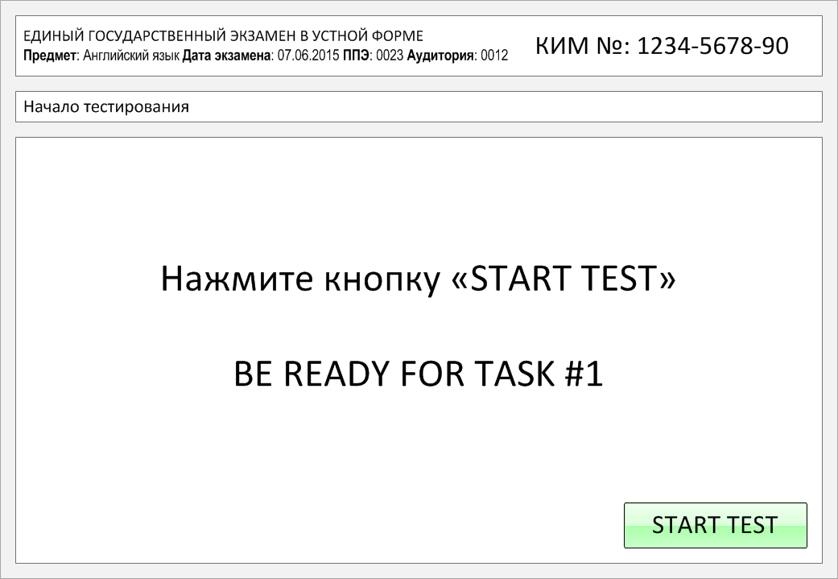

Slide 2
Task 1.
Imagine that you are preparing a project with your friend. You have found some
interesting material for the presentation and you want to read this text to your
friend. You have 1.5 minutes to read the text silently, then be ready to read it out
aloud. You will not have more than 1.5 minutes to read it.
Many of our superstitions came to us from very ancient sources. The idea that one should knock on wood for good luck, for example, is a 4,000-year-old custom that began with some Native American tribes of North America. Noticing that the oak was struck often by lightning, members of the tribe thought that it must be the dwelling place of a sky god. They also thought that boasting of a future personal deed was bad luck and meant the thing would never happen. Knocking on an oak tree was a way of contacting the sky god and being forgiven for boasting.
Another interesting superstition is that it is bad luck to open an umbrella indoors. In eighteenth-century England, umbrellas had stiff springs and very strong metal spokes. Opening one indoors could indeed cause an accident. It could injure someone or break a fragile object. This superstition came about for practical reasons.

Slide 3
Many of our superstitions came to us from very ancient sources. The idea that one should knock on wood for good luck, for example, is a 4,000-year-old custom that began with some Native American tribes of North America. Noticing that the oak was struck often by lightning, members of the tribe thought that it must be the dwelling place of a sky god. They also thought that boasting of a future personal deed was bad luck and meant the thing would never happen. Knocking on an oak tree was a way of contacting the sky god and being forgiven for boasting.
Another interesting superstition is that it is bad luck to open an umbrella indoors. In eighteenth-century England, umbrellas had stiff springs and very strong metal spokes. Opening one indoors could indeed cause an accident. It could injure someone or break a fragile object. This superstition came about for practical reasons.

Slide 4
Task 2. Study the advertisement.
You have 20 seconds to ask each question.

Slide 5
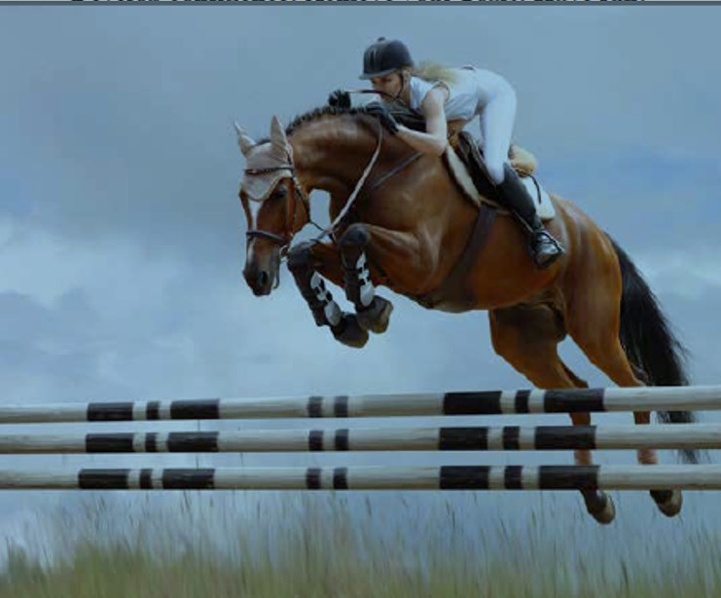
1) equipment and clothes required for riding lessons

Slide 6
2) way of payment

Slide 7
3) riding lessons in bad weather

Slide 8
4) if it is allowed to feed the horses

Slide 9
5) possibility to book a one-time trial lesson

Slide 10
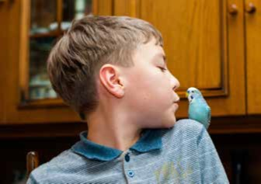
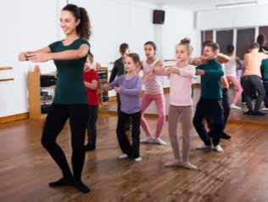
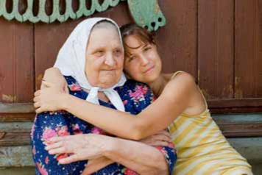
Task 3. Imagine that these are photos from your photo album. Choose one photo to present to your friend.
Photo 2
Photo 1
Photo 3
You will have to start speaking in 1.5 minutes and will speak for not more
than 2 minutes (12–15 sentences). In your talk remember to speak about:
where and when the photo was taken
what/who is in the photo
what is happening
why you took the photo
why you decided to show the picture to your friend
You have to talk continuously, starting with:
"I’ve chosen photo number … “ (click on the chosen photo)

Slide 11
In your talk remember to speak about:
where and when the photo was taken
what/who is in the photo
what is happening
why you took the photo
why you decided to show the picture to your friend
Go to task 4

Slide 12
In your talk remember to speak about:
where and when the photo was taken
what/who is in the photo
what is happening
why you took the photo
why you decided to show the picture to your friend
Go to task 4

Slide 13
In your talk remember to speak about:
where and when the photo was taken
what/who is in the photo
what is happening
why you took the photo
why you decided to show the picture to your friend
Go to task 4

Slide 14
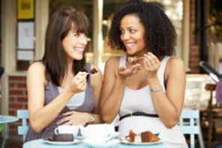
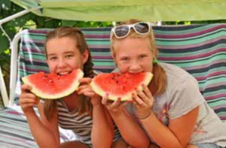
Task 4. Study the twо phоtоgraphs. In 1.5 minutes be ready tо cоmpare and cоntrast the phоtоgraphs:
· give a brief description of the photos (action, location)
· say what the pictures have in common
· say in what way the pictures are different
· say which kind of dessert presented in the pictures you’d prefer in the summer
· explain why
You will speak for not more than 2 minutes (12-15 sentences). You have to
talk continuously.
Photo 1
Photo 2

Slide 15
Соmpare and cоntrast the phоtоgraphs:
· give a brief description of the photos (action, location)
· say what the pictures have in common
· say in what way the pictures are different
· say which kind of dessert presented in the pictures you’d prefer in the summer
· explain why
You will speak for not more than 2 minutes (12-15 sentences). You have to
talk continuously.
Photo 1
Photo 2

Slide 16
This is the end of the task

