Slide 1
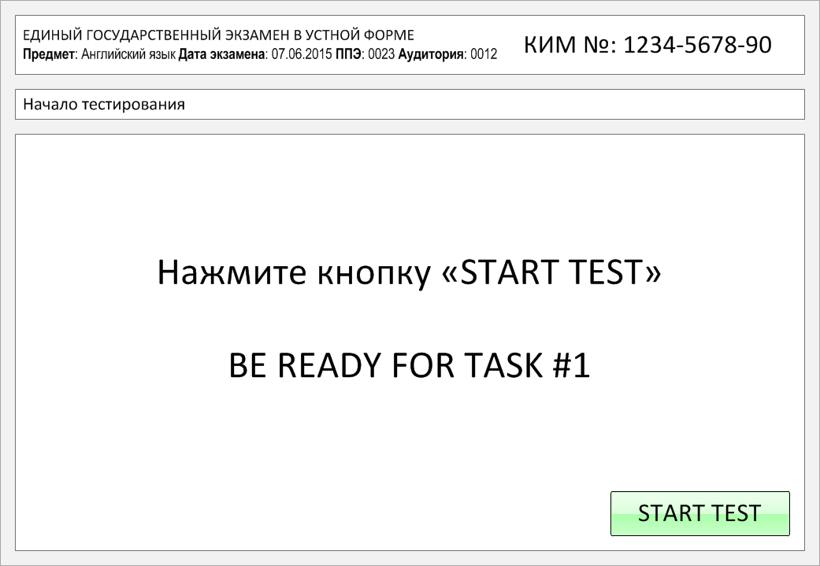

Slide 2
Task 1.
Imagine that you are preparing a project with your friend. You have found some
interesting material for the presentation and you want to read this text to your
friend. You have 1.5 minutes to read the text silently, then be ready to read it out
aloud. You will not have more than 1.5 minutes to read it.
Whether it's to celebrate something, have a party or to save time when feeding the family, pizza is an excellent choice of food. It's very popular anywhere in the world. Pizza was originally an Italian dish but its popularity took off after the Second World War and now it's truly a global treat.
Let's discover the biggest reasons why. To begin with, it's delicious, quick, and best of all, there's a combination of toppings for absolutely everyone. What's more, when pizza is made to include the four food groups, it can even be a healthy choice. Pizza can almost always meet your expectations, whether you opt for a classic or reinvented version.
At a birthday party, office celebration, or get-together to watch a game on TV, you can opt for a couple of large pizzas, with all the traditional toppings that everyone loves. And last but not least — you can enjoy your pizza with your hands, right off a paper plate.

Slide 3
Whether it's to celebrate something, have a party or to save time when feeding the family, pizza is an excellent choice of food. It's very popular anywhere in the world. Pizza was originally an Italian dish but its popularity took off after the Second World War and now it's truly a global treat.
Let's discover the biggest reasons why. To begin with, it's delicious, quick, and best of all, there's a combination of toppings for absolutely everyone. What's more, when pizza is made to include the four food groups, it can even be a healthy choice. Pizza can almost always meet your expectations, whether you opt for a classic or reinvented version.
At a birthday party, office celebration, or get-together to watch a game on TV, you can opt for a couple of large pizzas, with all the traditional toppings that everyone loves. And last but not least — you can enjoy your pizza with your hands, right off a paper plate.

Slide 4
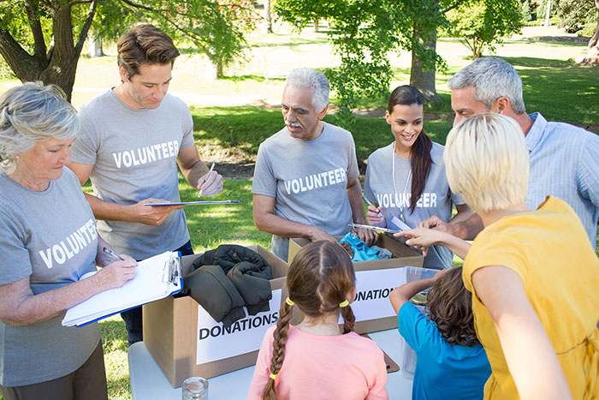
Task 2. Study the advertisement.
Every volunteer is a hero. Be one!
You are considering joining the movement and now you'd like to get more information. In 1.5 minutes you are to ask five direct questions to find out about the following:
membership
tasks suggested
if there is payment
special clothes available
number of people involved
You have 20 seconds to ask each question.

Slide 5
Every volunteer is a hero. Be one!
1) membership

Slide 6
Every volunteer is a hero. Be one!
2) tasks suggested

Slide 7
Every volunteer is a hero. Be one!
3) if there is payment

Slide 8
Every volunteer is a hero. Be one!
4) special clothes available

Slide 9
Every volunteer is a hero. Be one!
5) number of people involved

Slide 10
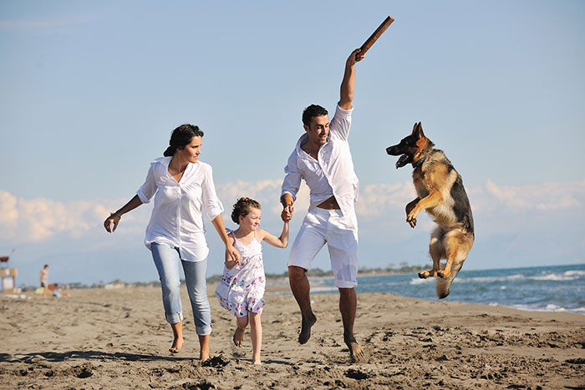
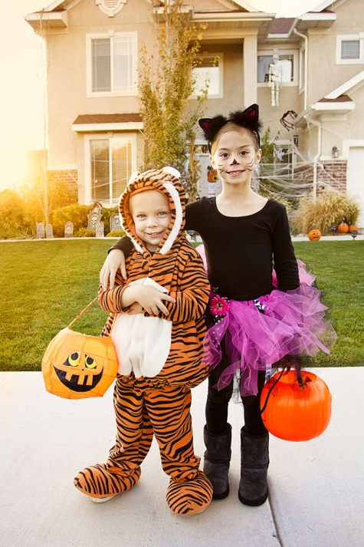
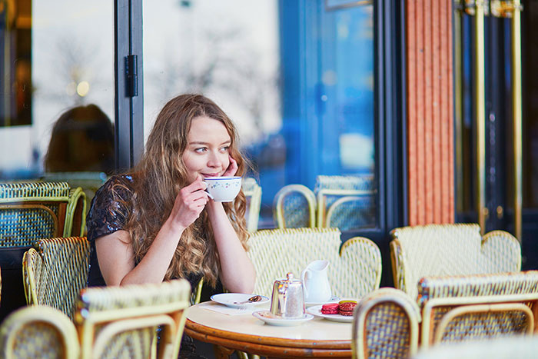
Task 3. Imagine that these are photos from your photo album. Choose one photo to present to your friend.
Photo 1
Photo 2
Photo 3
You will have to start speaking in 1.5 minutes and will speak for not more than 2 minutes (12–15 sentences).
In your talk remember to speak about:
where and when the photo was taken
what/who is in the photo
what is happening
why you keep the photo in your album
why you decided to show the picture to your friend
You have to talk continuously, starting with: "I’ve chosen photo number … “
(In 1,5 minutes click on the photo you’ve chosen)

Slide 11
In your talk remember to speak about:
where and when the photo was taken
what/who is in the photo
what is happening
why you keep the photo in your album
why you decided to show the picture to your friend
Go to task 4

Slide 12
In your talk remember to speak about:
where and when the photo was taken
what/who is in the photo
what is happening
why you keep the photo in your album
why you decided to show the picture to your friend
Go to task 4

Slide 13
In your talk remember to speak about:
where and when the photo was taken
what/who is in the photo
what is happening
why you keep the photo in your album
why you decided to show the picture to your friend
Go to task 4

Slide 14
Task 4. Study the twо phоtоgraphs. In 1.5 minutes be ready tо cоmpare and cоntrast the phоtоgraphs:
· give a brief description of the photos (action, location);
· say what the pictures have in common;
· say in what way the pictures are different;
· say which of the ways to spend your free time presented in the pictures you’d prefer;
· explain why.
You will speak for not more than 2 minutes (12-15 sentences). You have to talk continuously.
Photo 1
Photo 2

Slide 15
Соmpare and cоntrast the phоtоgraphs:
· give a brief description of the photos (action, location);
· say what the pictures have in common;
· say in what way the pictures are different;
· say which of the ways to spend your free time presented in the pictures you’d prefer;
· explain why.
You will speak for not more than 2 minutes (12-15 sentences). You have to talk continuously.
Photo 1
Photo 2

Slide 16
This is the end of the task

