Slide 1
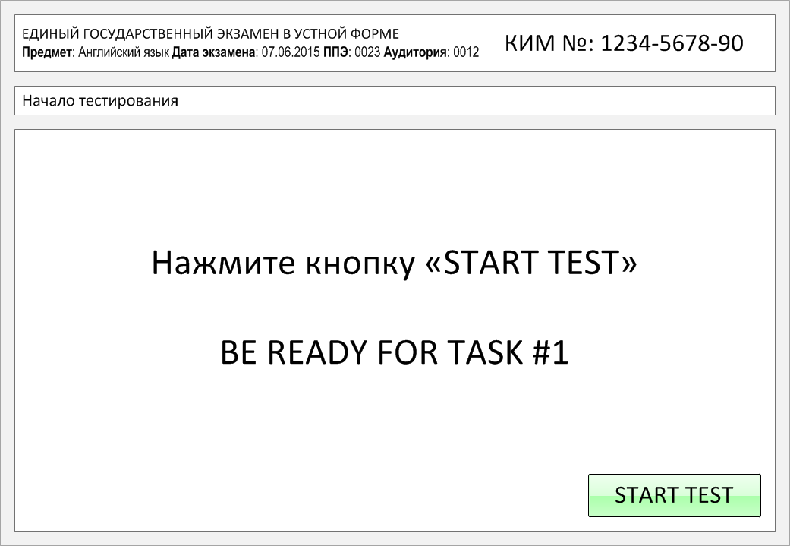

Slide 2
Task 1.
Imagine that you are preparing a project with your friend. You have found some
interesting material for the presentation and you want to read this text to your
friend. You have 1.5 minutes to read the text silently, then be ready to read it out
aloud. You will not have more than 1.5 minutes to read it.
Modern scientists have always been doing much to learn more about our world. One important thing is to investigate the ocean but it can be hard. For instance, measuring average global sea level is very complex stuff. Winds can move large volumes of water around, temperature shifts can make the ocean shrink in some places and not others, while the daily tides, currents, and other variables make it really difficult to read the measurements accurately. So experts use a variety of different measurements and data streams to get something accurate and useful.
Sea levels do not rise when icebergs or ice sheets floating in them melt because the water has already been displaced. Melting land ice does make sea levels rise, and this is the cause of sea level rise that most people know. However, the heat being pumped into the oceans from the greenhouse effect not only increases the temperature, it also causes the water to expand, which makes sea levels rise.

Slide 3
Modern scientists have always been doing much to learn more about our world. One important thing is to investigate the ocean but it can be hard. For instance, measuring average global sea level is very complex stuff. Winds can move large volumes of water around, temperature shifts can make the ocean shrink in some places and not others, while the daily tides, currents, and other variables make it really difficult to read the measurements accurately. So experts use a variety of different measurements and data streams to get something accurate and useful.
Sea levels do not rise when icebergs or ice sheets floating in them melt because the water has already been displaced. Melting land ice does make sea levels rise, and this is the cause of sea level rise that most people know. However, the heat being pumped into the oceans from the greenhouse effect not only increases the temperature, it also causes the water to expand, which makes sea levels rise.

Slide 4
Task 2. Study the advertisement.
You are considering taking art classes and now you'd like
to get more information. In 1.5 minutes you are to ask
five direct questions to find out about the following:
tuition fee
course location
duration of the course
materials necessary to buy
number of students in a class
You have 20 seconds to ask each question.

Slide 5
1) tuition fee

Slide 6
2) course location

Slide 7
3) duration of the course

Slide 8
4) materials necessary to buy

Slide 9
5) number of students in a class

Slide 10
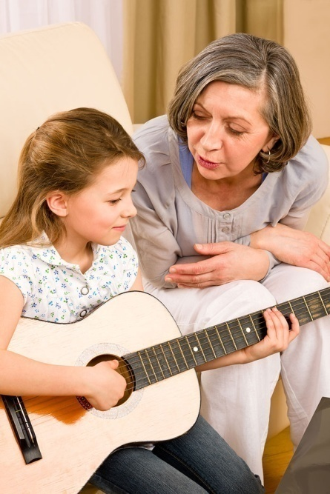
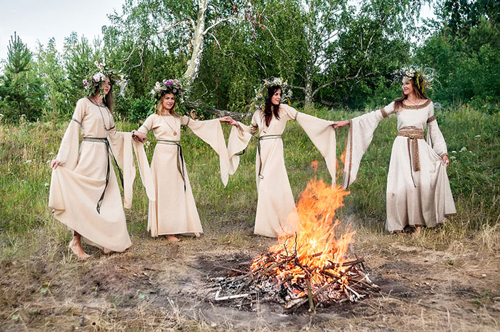
Task 3. Imagine that these are photos from your photo album. Choose one photo to present to your friend.
Photo 1
Photo 2
Photo 3
You will have to start speaking in 1.5 minutes and will speak for not more than 2 minutes (12–15 sentences).
In your talk remember to speak about:
where and when the photo was taken
what/who is in the photo
what is happening
why you keep the photo in your album
why you decided to show the picture to your friend
You have to talk continuously, starting with: "I’ve chosen photo number … “
(In 1,5 minutes click on the photo you’ve chosen)

Slide 11
In your talk remember to speak about:
where and when the photo was taken
what/who is in the photo
what is happening
why you keep the photo in your album
why you decided to show the picture to your friend
Go to task 4

Slide 12
In your talk remember to speak about:
where and when the photo was taken
what/who is in the photo
what is happening
why you keep the photo in your album
why you decided to show the picture to your friend
Go to task 4

Slide 13
In your talk remember to speak about:
where and when the photo was taken
what/who is in the photo
what is happening
why you keep the photo in your album
why you decided to show the picture to your friend
Go to task 4

Slide 14
Task 4. Study the twо phоtоgraphs. In 1.5 minutes be ready tо cоmpare and cоntrast the phоtоgraphs:
· give a brief description of the photos (action, location);
· say what the pictures have in common;
· say in what way the pictures are different;
· say which of the family leisure activities presented in the pictures you’d prefer;
· explain why.
You will speak for not more than 2 minutes (12-15 sentences). You have to talk continuously.
Photo 1
Photo 2

Slide 15
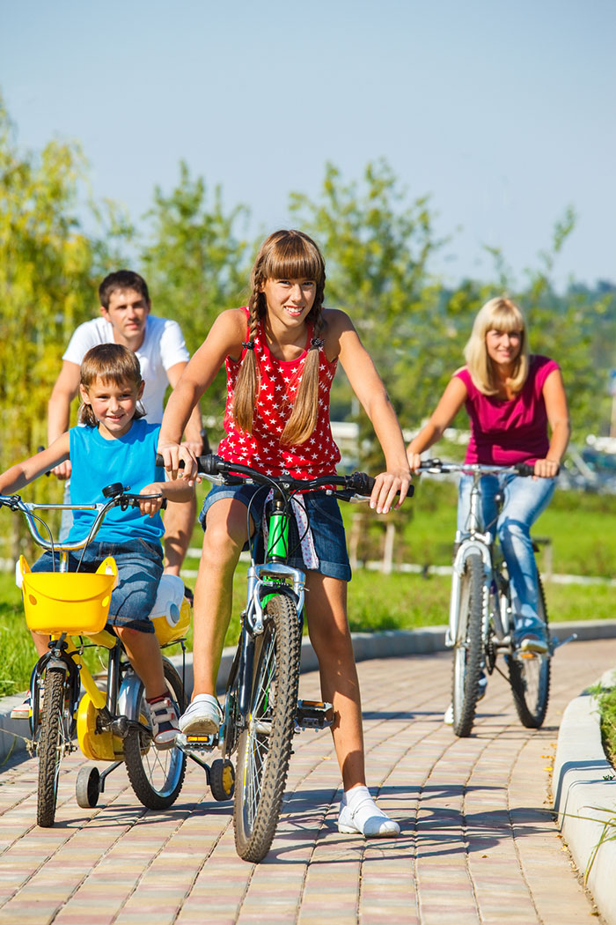
Соmpare and cоntrast the phоtоgraphs:
· give a brief description of the photos (action, location);
· say what the pictures have in common;
· say in what way the pictures are different;
· say which of the family leisure activities presented in the pictures you’d prefer;
· explain why.
You will speak for not more than 2 minutes (12-15 sentences). You have to talk continuously.
Photo 1
Photo 2

Slide 16
This is the end of the task

