Slide 1
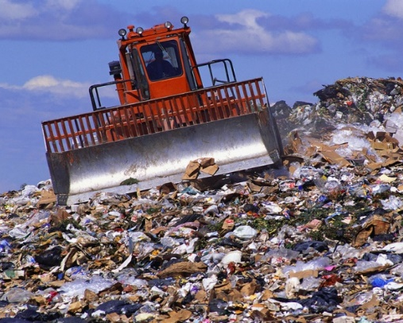
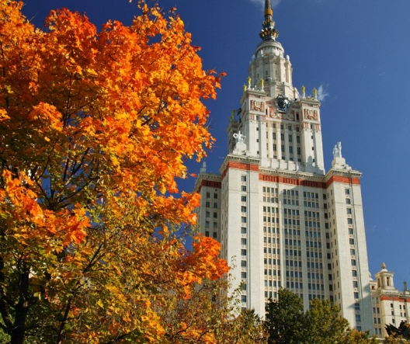
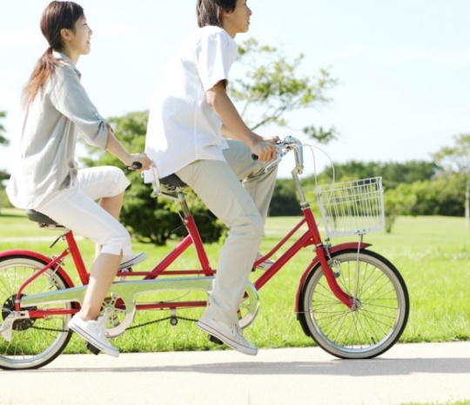
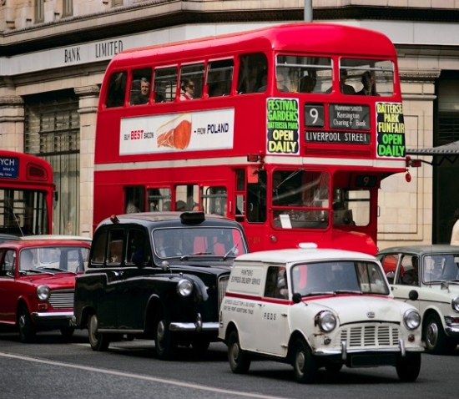
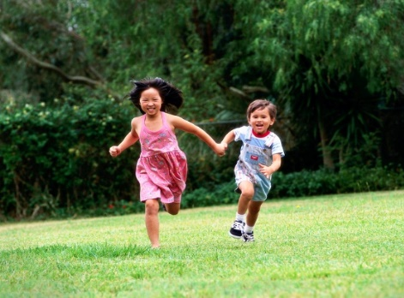
Match the suggestions to the results
people recycle things
people have more oxygen
have more trees/green areas
not be so much rubbish
people not drop litter in streets
people use bicycles
put bins on every street corner
people leave cars at home
children be able to play
cities be less polluted
create more parks
improve public transport

Slide 2
Conditionals Type 2.
Make sentences
people recycle things
not be so much rubbish

Slide 3
Conditionals Type 2.
If people recycled things, there wouldn’t be so much rubbish everywhere.

Slide 4
Conditionals Type 2.
Make sentences
people use bicycles
cities be less polluted

Slide 5
Conditionals Type 2.
If people used bicycles, our cities would be less polluted

Slide 6
Conditionals Type 2.
Make sentences
people leave cars at home
improve public transport

Slide 7
Conditionals Type 2.
If authorities improved public transport, people would leave their cars at home

Slide 8
Conditionals Type 2.
Make sentences
have more trees/green areas
people have more oxygen

Slide 9
Conditionals Type 2.
If cities had more trees and green areas, people would have more oxygen.

Slide 10
Conditionals Type 2.
Make sentences
Put bins on every street corner
people not drop litter in streets

Slide 11
Conditionals Type 2.
If the authorities put bins on every street corner, people would not drop litter in streets.

Slide 12
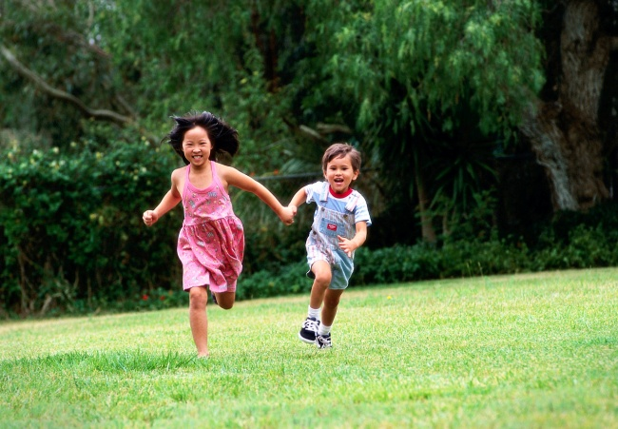
Conditionals Type 2.
Make sentences
create more parks
children be able to play

Slide 13
Conditionals Type 2.
If authorities created more parks, children would be able to play safely.

